Slide 1

Climate Action Plan (CAP)
Facility Ventilation Carbon Footprint
December 2023
Walter Sobkiw
www.cassbeth.com

Slide 2
Content
CAP
  Background
  Approach
  Proposed CAP Ventilation Goals
  Observations
  Ventilation & Power Model
Ventilation Background

Slide 3
Background
We know we need to reduce facility ventilation carbon footprints but not at the cost of lost health or epidemics
Facility ventilation rates have been dropping since the first energy crisis in the last century
With sustainability goals, ventilation rates are being forced to drop even further
Challenge is to increase existing poor ventilation rates while reducing carbon footprints
A systems perspective must be applied to the sustainability (carbon footprint) and ventilation challenges in facilities

Slide 4
Background
Any Climate Action Plan (CAP) should include carbon footprint impacts on ventilation performance levels and help establish a sustainable and healthy ventilation future everywhere.
This suggestion is based on COVID-19 research from a systems perspective that started in 2020

Slide 5
Approach
Gather Data & Develop Model
Determine existing ventilation performance levels
  Prepare a Ventilation Quality Improvement Indicator (QII) to independently gather data (one currently exists)
  Have room attendants (staff, professor, student, or IT staff, etc.) independently gather data per the QII to validate any existing data
  Data feeds into spreadsheets / database / online portal (software exists for online entries that can be provided)
Develop model to perform what-if analysis (prototype exists)
Example site survey of all classrooms in all schools - Philadelphia 234 schools, 12,000+ rooms
  https://docs.google.com/spreadsheets/d/18Kn2h5zS6ivX27-msM2Pdy10HUUWaUAomAaXJJ2FK7w/edit

Slide 6
Proposed CAP Ventilation Goals
Determine existing baseline ventilation performance levels and power needs for each room in all buildings by year 1
  There is existing power data for many buildings
  Ventilation levels need to be determined
State ventilation level requirement targets over a 5-year period
  Year 1: 5 ACH (CDC Guideline for all facilities)
  Year 2: 6 ACH (Harvard T.H. Chan 5-step guide to checking school ventilation)
  Year 5: 12 ACH (CDC Guideline for room airborne infections)
Targets apply to all buildings
ACH: Air Changes per Hour
ACH = Mechanical ACH + UV eACH + Other oACH

Slide 7
Observations
While climate action solutions are complex and difficult to implement, fixing the ventilation in facilities is relatively easy
The ventilation challenge is a social challenge, everyone assumes everything is okay, but it is not okay
Research suggests there are operational and maintenance problems with most facilities that must be corrected
Once operational and maintenance problems are corrected then some systems may be too small, and upgrades are needed
For facilities needing upgrades, data is needed for low carbon footprint solutions that also meet ventilation requirements

Slide 8
Observations
COVID-19 research from a system perspective suggests that an independent Ventilation QII should be used to gather operational, maintenance, and system performance data
A QII is documented evidence that is not easily refuted by outsourced energy companies or staff that place all their faith in automated sensors
Because facility ventilation has a large carbon footprint it should be an integral part of any Climate Action Plan

Slide 9
Observations
To ignore ventilation in Climate Plans runs the unnecessary risks of:
Unhealthy infrastructure that will make people sick and may lead to future epidemics
Poor carbon footprint management if poor solutions are selected

Slide 10
Ventilation and Power Model
Eventually CAP should quantify the facility carbon footprints
Ventilation requires power with a carbon footprint
Ventilation levels must be tied to ventilation carbon footprint
Cannot have poor ventilation to claim low carbon footprint
Model identifies ventilation power Vs. ventilation levels
Model assumes facility ventilation levels and ceiling heights
Assumptions need to become actual data
  Measure ventilation levels in each room
  Determine ceiling heights for accurate cubic feet
  Measure ventilation power (rather than use design data for watts/CFM)

Slide 11
There are Two Static Models
Fine Grain Model
  Data captured for each room in a building
  All rooms are summed for a building result
  Initially based on assumed data
  Once room data is captured using QIIs, results are actual
  This will surface rooms with poor ventilation
Coarse Grain Model
  Power and square feet data given for building
  Desired building ACH & eACH levels are selected
  Ventilation power needs are back calculated
  This will not surface rooms with poor ventilation
  This is a broad view with limited insights but quick and easy

Slide 12
Example Model Results
Scenario | Fine Grain Power | Coarse Grain Power | Fine Grain ACH | Coarse Grain ACH | Rating
Baseline | 28,179 | 29,277 | 3.4 | 4.0 | Poor
Arch A | 39,351 | 36,596 | 5.1 | 5.0 | CDC LVL
Arch B | 30,028 | 30,498 | 5.1 | 5.0 | CDC LVL
Arch C | 38,074 | 39,051 | 12.0 | 12.0 | CDC Airborne LVL
Assumptions
Room Height
Room CFM
Mech Watts / CFM
UV Watts / Cu-Ft
Fine Grain baseline has failed rooms
Givens
Square Feet
Givens shown in spreadsheet
Bld Avg kWh/Mon actual
Green Bld Avg kWh/Mon actual

Slide 13
CO2 per kWh
Type of Powerplant
Fuel | Efficiency | Percentage Used in United States | Total Energy (Billion kWh) | CO2 per kWh Created by Powerplant (lbs.)
Natural Gas | 38% | 38.60% | 1.575 | 0.9
Coal | 29% | 21.80% | 899 | 2.34
Oil | 31% | 0.50% | 19 | 1.78
Fossil Fuel Total |  | 60 9% | 2.493 | 1.42 Weighted Avg
Nuclear | 290% | 18.90% | 778 | 0.03
Wind | 1164% | 9.20% | 380 | 0.02
Hydro | 317% | 6.30% | 260 | 0.05
Solar | 207% | 2.80% | 115 | 0.11
Biomass | 52% | 1.30% | 55 | 0.51
Geothermal | 514% | 0 4% | 16 | 0.08
Renewable Fuel Total |  | 38.50% | 1,588 | 0.05 Weighted Avg
Total |  | 99 4% | 4,081 | 0.89 Weighted Avg
Compiled from US Dept. of Energy for various types of powerplants
www.quora.com/Whats-the-carbon-footprint-of-1-kWh-of-electricity (accessed 2023)

Slide 14
Ventilation Background

Slide 15
Introductions
Collaborated and shared COVID-19 systems research with others at Drexel University and the MITRE healthcare coalition starting in 2020
Research was about determining probability of infection using common operational living scenarios
Changed the dialogue to admit that the COVID-19 virus is airborne, and that ventilation is critical
Wrote a book: COVID-19 A Systems Perspective

Slide 16
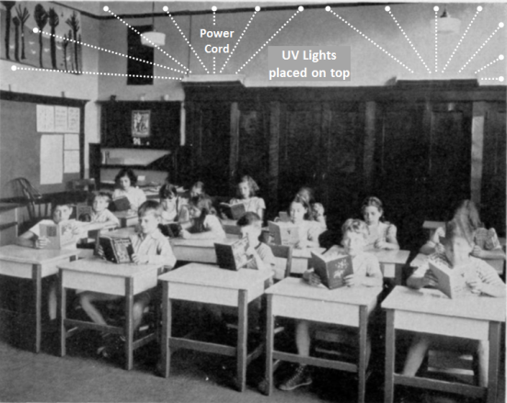
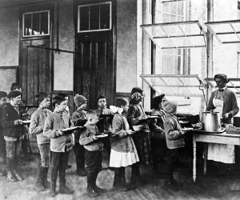
Our Parents and Grandparents
Swarthmore Public School Classroom
circa 1937 - 1943
Open windows Public School cafeteria
circa 1908
UPENN study with Ceiling Level UV lights.
First US fresh-air school for tubercular children opened in Providence in 1908 and by 1910 there were 65 fresh-air schools in the country.

Slide 17
Why is Ventilation Suddenly a Problem
COVID-19 is endemic, it is like tuberculosis, measles, and other airborne contagions from the previous century
It has been a leading cause of death for 2 years
To eventually eliminate tuberculosis and other airborne contagions, it took vaccines and modern forced air heat and cooling systems
Our building ventilation systems have been ignored during the time of great health when our parents and grandparents understood building ventilation

Slide 18
Professor Edward A. Nardell
Harvard Medical School
From Time Magazine February 1, 2022: If We're Going to Live With COVID-19, It's Time to Clean Our Indoor Air Properly, Edward A. Nardell is Professor of Global Health and Social Medicine, Harvard Medical School.
COVID-variants may be with us for years to come, and this will certainly not be the last respiratory virus pandemic. We have long suffered from annual contagious respiratory infections, but exceptionally low rates of influenza and common colds during COVID-precautions have demonstrated that not all of this suffering need happen. So, we need to think clearly and scientifically about how better we can reduce the spread of viruses indoors especially when and where masks will no longer be in common use.
Are there effective engineering controls that can help make indoor environments truly safer?

Slide 19
A Paradigm Shift to Combat Indoor Respiratory Infection
In May of 2021, 39 scientists published "A Paradigm Shift to Combat Indoor Respiratory Infection"
There is great disparity in the way we think about and address different sources of environmental infection. Governments have for decades promulgated a large amount of legislation and invested heavily in food safety, sanitation, and drinking water for public health purposes. By contrast, airborne pathogens and respiratory infections, whether seasonal influenza or COVID-19, are addressed weakly, if at all, in terms of regulations, standards, and building design and operation, pertaining to the air we breathe.

Slide 20
Facility Ventilation Challenge
VENTILATION: WHY does no one take it seriously? Jan Sundell,
Former Editor‐in‐Chief of Indoor Air
Key extracts paraphrased
Energy has been the top priority
Ventilation has always been seen as having a negative impact, more energy
Ventilation has been mainly seen as an engineering problem
Ventilation in reality is a public health topic
Ventilation, just installing ducts and fans, and filters, that are not properly checked
Can you trust an HVAC engineer?
Ventilation is something that companies make money by selling ducts, filters, fans
No one seems to realize that it is important to make it work
Students are not taught properly about ventilation. They are taught to design air conditioning!!!
Universities with HVAC education…. NO functioning VENTILATION
https://www.ncbi.nlm.nih.gov/pmc/articles/PMC8251269

Slide 21
Facility Ventilation Challenge
Jan’s friend, Jack Spengler
Harvard T.H. Chan School of Public Health, Cambridge
Jan’s words ring so true in our Time of COVID‐19. Over the summer of 2020, we assisted local school districts struggling to reopen. We found building management systems were dysfunctional, unit ventilators in a classroom being used as an extra shelf space with vents covered, and a basic lack of understanding about the importance of ventilation.
In our current Aviation Public Health Initiative with airlines, airports, and aircraft manufacturers, we again had to demonstrate the importance of ventilation as a critical mitigation strategy, particular when mask wearing, and physical distancing were not enough. It took the evidence from measurements we made on airplanes and terminal buses to convince the air carriers and airport operators of the importance of ventilation. We made the case that high ventilation rates needed to be maintained throughout the gate‐to‐gate time on a plane.
https://www.ncbi.nlm.nih.gov/pmc/articles/PMC8251269

Slide 22
Ventilation
Ventilation what is it?
We hear that we need ventilation in small indoor spaces, But why?
We hear we need to increase ventilation but what does that mean?

Slide 23
Ventilation what is it?
It is about Ventilation performance levels
Ventilation performance is measured as:
Air Changes Per Hour (ACH)
ACH is a measure of how often air changes in a room
  1 ACH changes the room air 1 time per hour
  20 ACH changes the room air 20 times per hour
  or every 3 minutes (60 min / 3 min = 20 ACH)
Disease specialists address ventilation only in ACH
ACH = Fan Cubic-feet per Hour / Room Cubic-feet

Slide 24
Ventilation what is it?
It is not about measuring and maintaining CO2 levels
Maintaining CO2 levels leads to a system with ACH levels that are too low such as 1 ACH or less
It is not about liters/min or cubic-feet/min per person, this will never provide visibility into the actual ACH level in a room and when scenarios are run the ACH levels are too low such as 1 ACH or less
Ventilation performance when dealing with airborne contagions is always in terms of ACH in a real room setting, not a lab or test fixture
Example: 60 min / air changed every 3 min = 20 ACH

Slide 25
Scenarios Analyzed
Key Research Findings
Small indoor space - problem is massive
Large indoor space - problematic
Outside - extremely rare
Mask on / off
Exposure time of 1, 4 , 8 hours
Various ventilation rates - key to reduce risk
Used Well-Riley equation to develop scenarios
Scenarios show probability of infection
99% to .0003%

Slide 26
What should be the ACH Level?
0 leads to infection
1 leads to infection we know from data
CDC recommends 12 ACH for a hospital room with airborne contagion
The number must be greater than 1
As ACH increases the risk of infection drops

Slide 27
Mental Models to Understand ACH
Many address ACH levels as a percent of remaining contagions after 1 ACH
  One air change removes approximately 63% of room air contaminants, and a second air change removes about 63% of what remains, and so on
Systems engineering safety and reliability analysis is about probabilities, relative probabilities and time before failure
Applying systems engineering safety and reliability concepts to ACH provides a quick view on the effectiveness of ACH levels and how one can behave

Slide 28
ACH Various Analysis Perspectives
ACH | Remaining Virus * 63% / AC | Time (mins.) removal: 99% efficiency * | Time (mins.) removal: 99.9% efficiency * | Infection Risk (1/ACH) Safety world | Time to Infection (hours) Reliability world
0 | 100% | - | - | 100% | 1 or .5 or .25
1 | 63% | - | - | 100% or 50% | 1 or 4 or 6
2 | 40% | 138 | 207 | 50% | 2
4 | 16% | 69 | 104 | 25% | 4
6 | 6% | 46 | 69 | 17% | 6
8 | 2% | 35 | 52 | 13% | 8
10 | 1% | 28 | 41 | 10% | 10
12 | 0.39% | 23 | 35 | 8% | 12
15 | 0.10% | 18 | 28 | 7% | 15
20 | 0.01% | 14 | 21 | 5% | 20
50 | - | 6 | 8 | 2% | 50
* CDC Appendix B. Air Guidelines for Environmental Infection Control in Health-Care Facilities (2003), Medical world

Slide 29
Where do ACH standards and guidelines come from?
ASHRAE American Society of Heating, Refrigerating and Air-Conditioning Engineers
CDC Centers for Disease Control and Prevention
DOD Department of Defense Standards
ISO International Organization for Standardization
Others
Most of the ACH levels are based on comfort levels except for when airborne contagion mitigation is required in hospitals

Slide 30
ACH Standards & Guidelines
Area | ACH min | ACH max | Source | Area | ACH min | ACH max | Source
Hospital Trauma room | 15 | - | CDC | Classroom (Art) | 16 | 20 | Industry
Hospital room airborne precautions | 12 | - | CDC | Malls | 6 | 10 | Industry
Hospital operating room | 25 | - |  | Office | 8 | 30 | Greenheck
Hospital rooms | 6 | 10 | Industry | Engine Room | 20 | 60 | Greenheck
Restaurants | 8 | 12 | Industry | Kitchen | 12 | 60 | Greenheck
Restaurants | 8 | 20 | NCI | Kitchen | 7 | 8 | NCI

Slide 31
ACH Standards & Guidelines
Area | ACH min | ACH max | Source | Area | ACH min | ACH max | Source
Restaurants | 15 | 20 | wiki | Kitchen | 14 | 18 | NCI
Bar | 15 | 30 | Greenheck | Kitchens | 15 | 30 | Industry
Bar | 15 | 20 | NCI | Retail | 6 | 10 | NCI, wiki, Industry
Bar | 15 | 20 | wiki | Laboratory | 12 | 30 | Greenheck
School Classroom | 4 | 12 | Industry | Laboratory | 6 | 12 | wiki
Auditorium | 8 | 15 | Industry | Club Houses | 20 | 30 | Industry
Assembly Hall | 6 | 8 | Industry | Theatres | 8 | 15 | Industry
Swimming Pool | 20 | 30 | Industry

Slide 32
What have facility managers done?
Hawaiian airlines ventilation performance level is 20 ACH and they posted it for all passengers to see on their entertainment screens
Philadelphia restaurant program is 15 ACH and 106 restaurants participated
Philadelphia school district determined the ventilation rate in each room in all their schools and posted the data online, 234 schools 12,000+ rooms
New York and Boston school districts did spot checks and posted their data online

Slide 33
Facility Types
Research Findings
Facility Type | ACH Levels | Maintenance | Operations
Elite | Excellent | Excellent | Excellent
Medium | Lower | Excellent | Excellent
Low End | Lower | Poor | Excellent
Low End | Lower | Excellent | Poor
Very Low End | None | Poor | Poor
Where does your facility fall?

Slide 34
Ventilation Approaches
Approach | ACH / e ACH Levels | Comments
Natural Ventilation | 35+ | Open windows & Doors
HVAC | 4 to 6 typical | 12+ ACH are elite settings
Exhaust Fans | 60+ | Old bars, auto & machine shops…
Ceiling Level UV Lights | 24+ eACH | Well established 80+ years
Far UV 222 Lights | 24+ eACH | No need for surface cleaning
Room sanitizers | 1-2 | too small for public rooms, may be okay for small 1 person office
Will revisit the technologies at the end

Slide 35
HVAC Systems
Continuous Ventilation - CV
  Fans are always on, air is constantly exchanged regardless of temperature, humidity, or CO2 levels
  ACH level is constant
Demand Controlled Ventilation - DCV
  Fans are on only based on CO2 level, temperature, humidity, timers, occupancy detectors
  ACH level changes and does drop to zero
On Demand Ventilation - DV
  Fans are turned on manually by occupant using thermostat switch
  When fans are On ACH level is constant level
  When fans are Off ACH level is zero

Slide 36
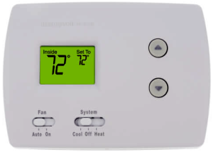
Home Ventilation Actions & Costs
Turn on the HVAC fan when guests arrive and turn it off when they leave
What about costs?
Typical home fan motor takes the equivalent power of 1 to 3, 100-watt lightbulbs

Slide 37
Public Buildings Ventilation Actions & Costs
CDC guidance
  Turn on ventilation system 1 hour before public arrives
  Turn off ventilation system 1 hour after public leaves
  DCV systems must be set to maximum ventilation
Most commercial facilities are CV or DCV systems and fans run all the time, no cost impacts
  However, there are serious operational & maintenance issues
  That is why ACH levels must be determined and posted
Facilities using on demand systems, some cost impacts
  Negligible, fans take little power compared to heating and cooling
  Instead of using HVAC or exhaust fans can use ceiling level UV or FAR UV 222 systems, run at about 10% of mechanical motors

Slide 38
Commercial Building Challenges
It is more about proper maintenance and operations because this will lead to ACH = 0 or ACH = 1
Are vents blocked
Are dampers partially closed by someone
Are timers working properly
Are sensors, fans, and dampers working properly
Do vents have streamers so people can see system is working
Periodic inspections with documented evidence
will ensure effective maintenance and operations

Slide 39
What Can We Do
Operations
Turn on the HVAC FANs 1 hour before people enter and turn off 1 hour after people leave facility
When you enter the facility, make sure fans are turned on, if not turn them on
Place a sign at each thermostat stating to turn on fan and show how to turn on the fan
If fans fail to operate or you are unable to see thermostat display report it immediately
Setup a training session to show people how to turn on fans

Slide 40
What Can We Do
Maintenance
Make sure all the HVAC fans work
Make sure the vents are not blocked or closed
Place streamers on all the vents so people can see they work
Replace the batteries in all the thermostats so that the displays are visible, and people can see what they are doing
Ensure that the filters are replaced every 3 months

Slide 41
What Can We Do
Measure ACH levels
Using anemometers, measure air flow from each vent
Calculate the measured ACH levels
Gather design data to determine design ACH levels
Compare design with measured ACH for each room
Periodically measure air flow to detect ACH level drops

Slide 42
Measured ACH Levels
Real World Findings
Num | Room Name | ACH Measured | Control Zone # | System ON yes, no, fail
1. | Ballroom Ceiling Vents | 5.7 | 1, 2 | No
2. | Kitchen | 11 | 1 | No
3. | Library | 6.3 | 3 | No
4. | Sitting Room | 5.2 | 3 | No
5. | Conference Room | 0 | 3 ? | Fail
6. | Office | ? | ? | ?
7. | Exercise Room | 3.2 | 5 | No
8. | Pool Room | 3.6 | 6 | Yes
9. | Game Room 1 | 0 | 4 | Fail
10. | Game Room 2 | 0 | 4 | Fail

Slide 43
Measured ACH Levels
Real World Findings
Num | Room Name | ACH Measured | Control Zone # | System ON yes, no, fail
11. | Arts and Crafts Room | 0 | 4 | Fail
12. | Women's Room | ? | ? | ?
13. | Men's Room | 0 | ? | Fail
14. | Lobby | 3.2 | 3 | No
15. | Reception and Hall | 7.6 | 3 | No
16. | Hall 1 Ballroom | 0 | 3 ? | No
17. | Hall 2 Pool Exercise | 0 | 4 | Fail
18. | Hall 3 Game Area | 0 | 4 | Fail
19. | Women’s Pool Area | ? | ? | ?
20. | Men’s Pool Area | 6.5 | ? | Partial Yes
21. | Swimming Pool Floor Vents | 9.9 | ? | Yes

Slide 44
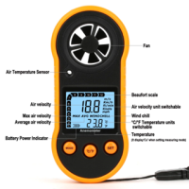
Tools to Measure ACH Levels
Developed by Philadelphia Restaurant Program
Tape measure to determine room size
Anemometer
https://www.amazon.com/Anemometer-Handheld-Detector-Temperature-Windsurfing/dp/B07ZJ38ZMX
ACH = all vents cu-ft per hour / room cubic feet

Slide 45
Facility Ventilation Search Engine
https://www.cassbeth.com/fvse.html
2900+ buildings with ventilation performance levels
Search examples
  Philadelphia Schools (ACH site survey data)
  Philadelphia Restaurant Program (ACH site survey data)
  School
  Restaurant
  Airport
  Airplane

Slide 46
Suggested Short Term Action Plan
Fix broken fans so that they operate
Fix areas that have zero ventilation readings
Open any closed dampers and vents because of previous complaints of hot or cold air
Adjust or change vent types so that there are no complaints but keep the vents open
Post signs to turn on the fans and provide simple instructions
Post certificates at each thermostat with a date showing last maintenance date and average ACH level
Place streamers on all vents

Slide 47
HVAC Inspection Certificate
Zone (1, 2, 3, 4, 5, 6, pool): example A
HVAC Vendor Name & Visit date: HVAC 05/21/22
Filter Change Date & MERV Rating: 5/21/22 MERV 13
Fan Mode Operational (yes/no): Yes
All Vents Operational (yes/no): Yes
Thermostat Display Visible: (yes/no): Yes
Timers Working & Set: (yes/no): Yes
Thermostat Instructions: (yes/no): Yes
Staff Turn On Fans On Entry (yes/no): Yes
Fan CFM: 1,600

Slide 48
Room Certificate Key Elements
Room Name & Zone: 136B Classroom
Square feet: 1142
Cubic feet: 9136
CFM: 483
ACH Level: 3.1
Vents Unblocked: yes/no Yes
Dampers Open: yes/no Yes
Timers Working: yes/no no data
Inspection Authority and Date: Phila School District, 2021
Comments: Posted Online by Phila

Slide 49
Building Certificate Key Elements
Building Name & Address: Thomas Edison High School
Square feet: 179,612
Cubic feet: 1,436,896
CFM: 89,361
Min ACH Level: 0.7
Max ACH Level: 73.2
Average ACH Level: 5.1
Inspection Authority and Date: Phila School District, 2021
Comments: Posted Online by Phila

Slide 50
UV Systems
Ceiling level / upper room UV-C and FAR UV-222
The Second Gilbert W. Beebe Webinar: Safety and Efficacy of UVC to Fight Covid-19, National Academies of Sciences, Engineering, and Medicine, Sep 16, 2020.
https://www.nationalacademies.org/event/09-16-2020/the-second-gilbert-w-beebe-webinar-safety-and-efficacy-of-uvc-to-fight-covid-19
The National Academy of Sciences (NAS) is a private, non-profit society of distinguished scholars. Established by an Act of Congress, signed by President Abraham Lincoln in 1863, the NAS is charged with providing independent, objective advice to the nation on matters related to science and technology.

Slide 51
UV Systems
Ceiling level / upper room UV-C lights
  Proven technology, massive science & engineering going back to 1937
  Used in commercial & industrial settings and public buildings like hospitals, elite schools, elite restaurants, elite condominiums, etc.
  This will add an additional 24 eACH to a room
FAR UV-222 lights
  Relatively new based on LED technology
  Science & engineering based on ceiling level UV-C lights
  This will add an additional 24 eACH to a room
  Will eliminate surface cleaning need

Slide 52
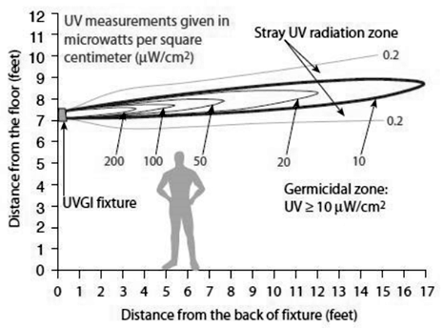
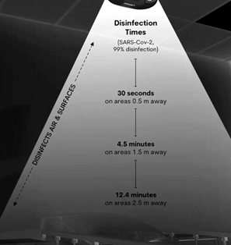
Ceiling Level UV-C and FAR UV-222 Characteristics eACH = 24
Ceiling Level UV-C
FAR UV-222

Slide 53
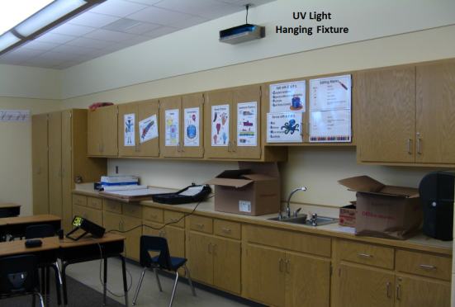
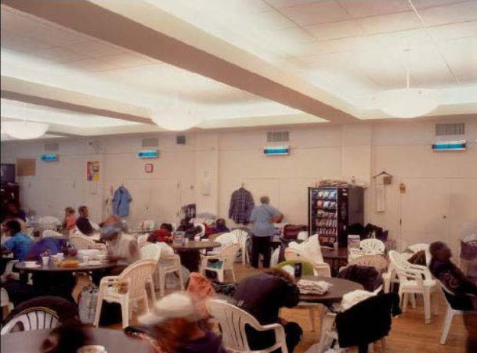
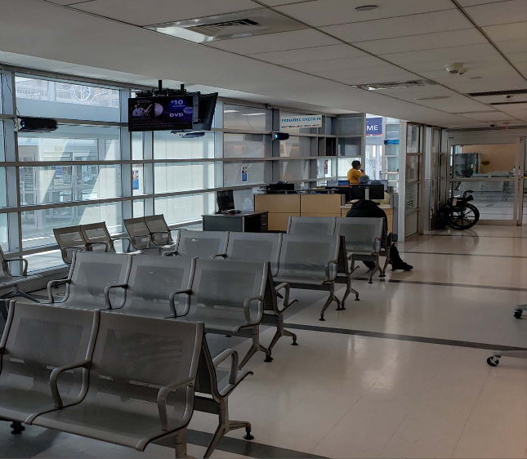
Ceiling Level
UV-C Examples

Slide 54
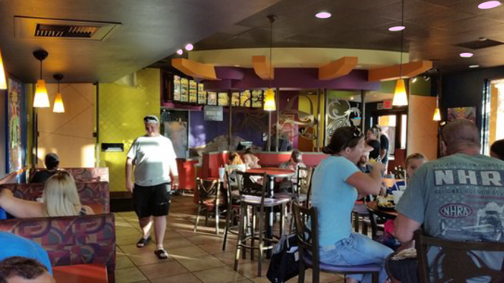
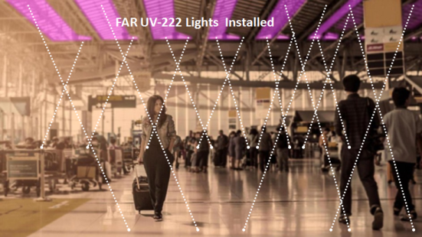
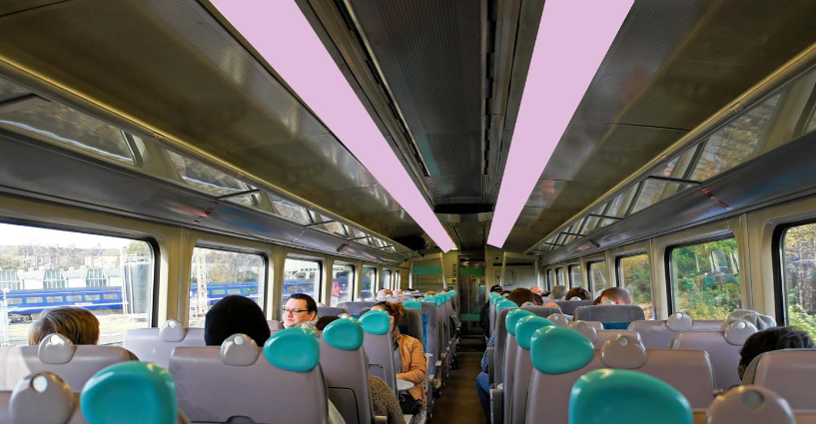
FAR UV-222 Examples
Surface Cleaning NOT Required

Slide 55
Infrastructure Size
Facilities | Number of Facilities
School Districts | 16,800
K-12 Schools In The U.S | 130,930
Restaurants 2018 | 660,755
Bars & Night Clubs 2021 | 59,052
U.S. Commercial Buildings 97 Billion Square Feet 2018 | 5,900,000
Brick-and-mortar Retail Stores 2020 | 328,208
Veterinary Clinics | 28,000
Assisted Living Facilities | 30,600
Physical Therapy Rehabilitation | 45,905
Nursing Homes | 15,600
Hospitals 2019 | 13,944
Urgent Care Facilities | 9,616

Slide 56
ACH Impact on Lives Saved
Naturally Immune % | Vaccine Effectiveness % | Vaccinated % | Deaths @ 3.5% * | UV-C or FAR UV-222 | Deaths @ 3.5% (With UV) | Ventilation Effectiveness 4 AUC | Deaths @ 3.5% (With UV + Ventilation)
10% | 70% | 70% | 5,269,320 | 90% | 526,932 | 28% | 379,391
10% | 90% | 90% | 1,963,080 | 90% | 196,308 | 28% | 141,342
0% | 70% | 70% | 5,854,800 | 90% | 585,480 | 28% | 421,546
0% | 90% | 90% | 2,181,200 | 90% | 218,120 | 28% | 157,046
.
0% | 0% | 0% | 11,480,000 | 90% | 1,148,000 | 28% | 826,560
10% | 0% | 0% | 10,332,000 | 90% | 1,033,200 | 28% | 743,904
* For less than 3.5% just divide all the numbers by 3 and they are still massive
2020 Analysis: impact of each of the mitigation subsystems on lives saved

Slide 57
Observations
In the last century, our parents and grandparents had to deal with tuberculosis and other deadly infections
Vaccines did a great deal to eliminate those contagions, but they would not have worked without the introduction of forced air HVAC systems and ceiling level UV systems
Unlike in the last century no new technology is needed, we just need to use what our parents and grandparents developed
There always will be unvaccinated people
The system solution must use vaccines + ventilation
The analysis clearly shows why; large numbers of people will continue to get sick and die – see this research findings

Slide 58
Suggested Path Forward
Ventilation awareness must be developed just like there is awareness of sustainability & climate change
Ventilation education for engineers is needed to address the key system drivers and remove misconceptions
Ventilation education for the general population is needed so that they can hold government and industry accountable
Provide Ventilation Quality Improvement Indicators that anyone can implement in any facility to start the changes

