Slide 1
Building Ventilation
In The Age Of Contagions
Walter Sobkiw
May 10, 2022

Slide 2
Why is Ventilation Suddenly a Problem
COVID-19 is endemic, it is like tuberculosis, measles, and other airborne contagions from the previous century
It has been a leading cause of death for 2 years
To eventually eliminate tuberculosis and other airborne contagions, it took vaccines and modern forced air heat and cooling systems
Our building ventilation systems have been ignored during the time of great health when our parents and grandparents understood building ventilation

Slide 3
Professor Edward A. Nardell
Harvard Medical School
From Time Magazine: If We're Going to Live With COVID-19, It's Time to Clean Our Indoor Air Properly, Edward A. Nardell is Professor of Global Health and Social Medicine, Harvard Medical School.
COVID-variants may be with us for years to come, and this will certainly not be the last respiratory virus pandemic. We have long suffered from annual contagious respiratory infections, but exceptionally low rates of influenza and common colds during COVID-precautions have demonstrated that not all of this suffering need happen. So, we need to think clearly and scientifically about how better we can reduce the spread of viruses indoors especially when and where masks will no longer be in common use.
Are there effective engineering controls that can help make indoor environments truly safer?

Slide 4
A Paradigm Shift to Combat Indoor Respiratory Infection
In May of 2021, 39 scientists published "A Paradigm Shift to Combat Indoor Respiratory Infection"
There is great disparity in the way we think about and address different sources of environmental infection. Governments have for decades promulgated a large amount of legislation and invested heavily in food safety, sanitation, and drinking water for public health purposes. By contrast, airborne pathogens and respiratory infections, whether seasonal influenza or COVID-19, are addressed weakly, if at all, in terms of regulations, standards, and building design and operation, pertaining to the air we breathe.

Slide 5
Ventilation
Ventilation what is it?
We hear that we need ventilation in small indoor spaces, But why?
We hear we need to increase ventilation but what does that mean?

Slide 6
Ventilation what is it?
It is about Ventilation performance levels
Ventilation performance is measured as Air Changes Per Hour (ACH)
ACH is a measure of how often air changes in a room
  1 ACH changes the room air 1 time per hour
  20 ACH changes the room air 20 times per hour
  or every 3 minutes (60 min / 3 min = 20 ACH)
Disease specialists address ventilation only in ACH
ACH = Fan Cubic-feet per Hour / Room Cubic-feet

Slide 7
Ventilation what is it?
It is not about measuring and maintaining CO2 levels
Maintaining CO2 levels leads to a system with ACH levels that are too low such as 1 ACH or less
It is not about Liters/min or cubic-feet/min per person, this will never provide visibility into the actual ACH level in a room and when scenarios are run the ACH levels are too low such as 1 ACH or less
Ventilation performance when dealing with airborne contagions is always in terms of ACH in a real room setting, not a lab or test fixture
Example: 60 min / air changed every 3 min = 20 ACH

Slide 8
Scenarios Analyzed
Small indoor space - problem is massive
Large indoor space - problematic
Outside - extremely rare
Mask on / off
Exposure time of 1, 4 , 8 hours
Various ventilation rates - key to reduce risk
Scenarios show probability of infection 99% to .0003%

Slide 9
What should be the ACH Level?
0 leads to infection
1 leads to infection we know from data
CDC recommends 12 ACH for a hospital room with airborne contagion
The number must be greater than 1
As ACH increases the risk of infection drops

Slide 10
What have facility managers done?
Hawaiian airlines ventilation performance level is 20 ACH and they posted it for all passengers to see on their entertainment screens
Philadelphia restaurant program is 15 ACH and 106 restaurants participated
There is a public database with hundreds of facilities showing what they have done
https://www.cassbeth.com/cleanairbuildings/index.html

Slide 11
What Must Happen
Facility managers should post their ventilation rates in terms of ACH in all spaces and as a summary for the whole building.

Slide 12
What is the future
Building codes will change because there will be no choice
Certificates of occupancy will include ventilation performance levels as ACH

Slide 13
Ventilation Approaches
Natural
HVAC – Heating Ventilation & Cooling
Exhaust Fans
Ceiling Level UV Lights
Far UV 222 Lights
Room sanitizers are too small for most public rooms, may be okay for small 1 person office

Slide 14
What About The Home
Turn on the HVAC fan when guests arrive and turn it off when they leave
What about costs?
Typical home fan motor takes the equivalent power of 1 to 3, 100-watt lightbulbs

Slide 15
Commercial Facility Costs
Must turn on ventilation system 1 hour before and after the public arrives and leaves
Most commercial facilities are not on demand systems and the fans run all the time, no cost impacts
  However, there are serious maintenance issues
  That is why the ACH levels must be determined and posted
Facilities using on demand systems, some cost impacts
  They are negligible because the fans take little power once compared to heating and cooling
  Instead of using the HVAC or exhaust fans they can install ceiling level UV or far UV 222 systems, which will run at about 10% of the mechanical motors

Slide 16
Where do ACH standards and guidelines come from?
ASHRAE
CDC
Department of Defense via DOD standards
ISO
Others
Most of the ACH levels are based on comfort except for when airborne contagion mitigation is required in hospitals

Slide 17
ACH Standards & Guidelines
Area | ACH min | ACH max | Source | Area | ACH min | ACH max | Source
Hospital Trauma room | 15 | - | CDC | Classroom (Art) | 16 | 20 | EPA
Hospital room airborne precautions | 12 | - | CDC | Malls | 6 | 10 | EPA
Hospital operating room | 25 | - |  | Office | 8 | 30 | Greenheck
Hospital rooms | 6 | 10 | EPA | Engine Room | 20 | 60 | Greenheck
Restaurants | 8 | 12 | EPA | Kitchen | 12 | 60 | Greenheck
Restaurants | 8 | 20 | NCI | Kitchen | 7 | 8 | NCI

Slide 18
ACH Standards & Guidelines
Area | ACH min | ACH max | Source | Area | ACH min | ACH max | Source
Restaurants | 15 | 20 | wiki | Kitchen | 14 | 18 | NCI
Bar | 15 | 30 | Greenheck | Kitchens | 15 | 30 | EPA
Bar | 15 | 20 | NCI | Retail | 6 | 10 | NCI, wiki, EPA
Bar | 15 | 20 | wiki | Laboratory | 12 | 30 | Greenheck
School Classroom | 4 | 12 | EPA | Laboratory | 6 | 12 | wiki
Auditorium | 8 | 15 | EPA | Club Houses | 20 | 30 | EPA
Assembly Hall | 6 | 8 | EPA | Theatres | 8 | 15 | EPA

Slide 19
Commercial Building Challenges
It is more about proper maintenance and operation because this will lead to ACH = 0 or ACH = 1
Are vents blocked
Are dampers partially closed by someone
Are timers working properly
Are sensors, fans, and dampers working properly
Do vents have streamers so people can see system is working
Periodic inspections with documented evidence using certificates that are posted will ensure effective maintenance

Slide 20
Room / Zone Certificate Key Elements
Room / Zone Name:
Square feet:
Cubic feet:
CFM:
ACH Level:
Vents Unblocked: yes/no
Dampers Open: yes/no
Timers Working: yes/no
Inspection Authority and Date:
Comments:

Slide 21
Building Certificate Key Elements
Building Name & Address:
Square feet:
Cubic feet:
CFM:
Min ACH Level:
Max ACH Level:
Average ACH Level:
Inspection Authority and Date:
Comments:

Slide 22
Final Comments
In the last century, our parents and grandparents had to deal with tuberculosis and other deadly infections
Vaccines did a great deal to eliminate those contagions, but they would not have worked without the introduction of forced air HVAC systems and ceiling level UV systems
Unlike in the last century no new technology is needed, we just need to use what our parents and grandparents developed
There always will be unvaccinated people
The system solution must use vaccines + ventilation
The analysis clearly shows why; large numbers of people will continue to get sick and die – see this research findings

Slide 23
Final Comments
It will take years for the building codes to change to include contagion mitigation, so what can we do?
As responsible managers of our children’s future
Stop using my original phrase of increase ventilation
We must talk in terms of ventilation performance levels using the decades old ACH levels
We must post ACH levels throughout our buildings

Slide 24
Final Comments
We are not here to determine the future minimum ACH levels that will become part of future building certificates of occupancy
We are here to measure and document the building ventilation levels and post the resulting ACH performance levels throughout the building

Slide 25
Some Screen Shots

Slide 26
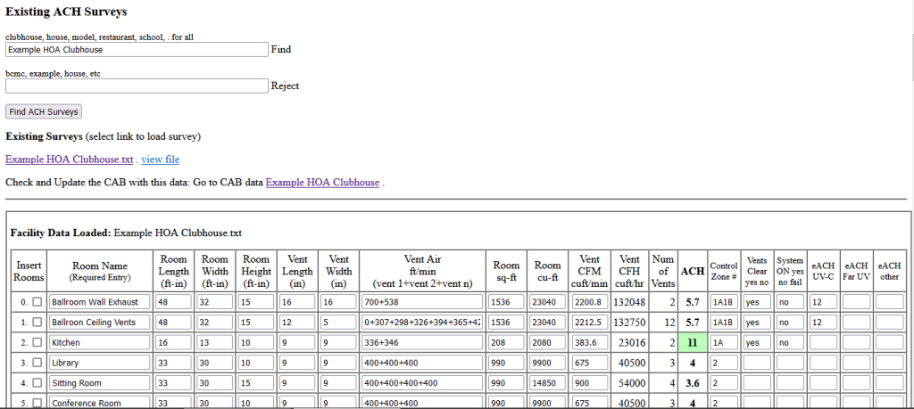
ACH Calculation Tool

Slide 27
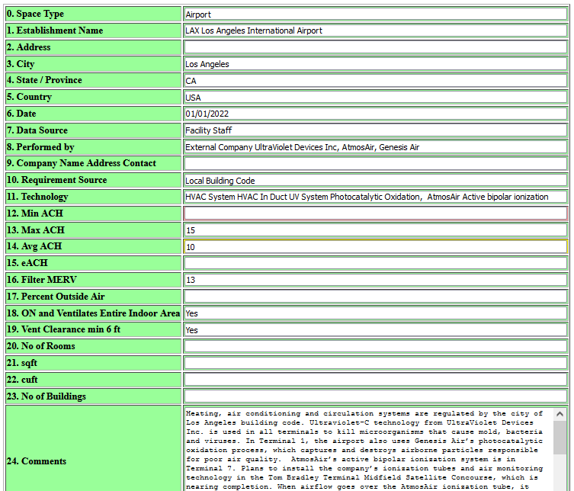
CAB Entries

Slide 28
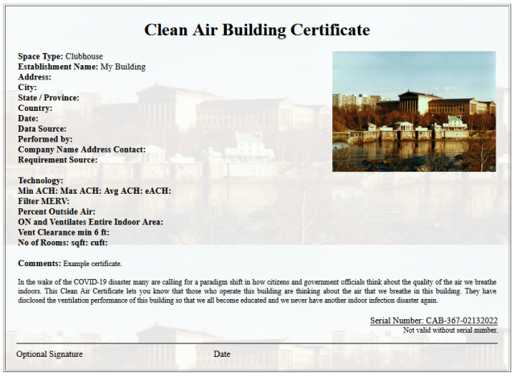
CAB Certificate

Slide 29
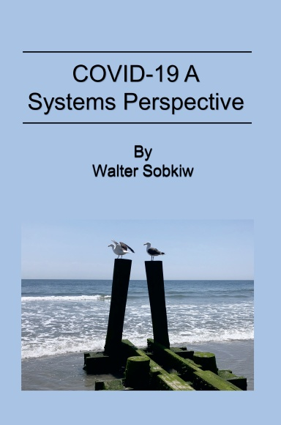
Links & Contact
COVID-19 Research From A Systems Perspective
https://www.cassbeth.com/covid-19/faq.html
https://www.cassbeth.com/cleanairbuildings/index.html
https://www.cassbeth.com/covid-19/index.html
walt@cassbeth.com
walter.sobkiw@drexel.edu

Slide 30
Walt’s Bio
Walt changed the dialogue to admit that the COVID-19 virus is airborne, and that ventilation is critical
Walt collaborated and shared his research with others at Drexel University and the MITRE healthcare coalition starting in 2020
His research was about determining probability of infection using common operational living scenarios
He wrote a book: COVID-19 A Systems Perspective

