Slide 1

Building Ventilation
What Everyone Should Know
Presented to a Homeowners Association Residents
Walt Sobkiw
June 2022
This is ongoing COVID-19 research from a systems perspective
Disclaimer: This event is not sponsored or approved by the Homeowners Association.

Slide 2
Introductions
Collaborated and shared COVID-19 systems research with others at Drexel University and the MITRE healthcare coalition starting in 2020
Research was about determining probability of infection using common operational living scenarios
Changed the dialogue to admit that the COVID-19 virus is airborne, and that ventilation is critical
Wrote a book: COVID-19 A Systems Perspective

Slide 3
Introductions
Are there any
Licensed doctors or pharmacists with an infection disease background where they needed to maintain certified facilities
HVAC staff that work with airborne contagion mitigation ventilation systems
Ceiling Level / Upper Room UV-C or FAR UV specialists that work with airborne contagion mitigation systems
Engineers or scientists performing research on airborne contagion mitigation systems
HVAC staff or facility managers

Slide 4
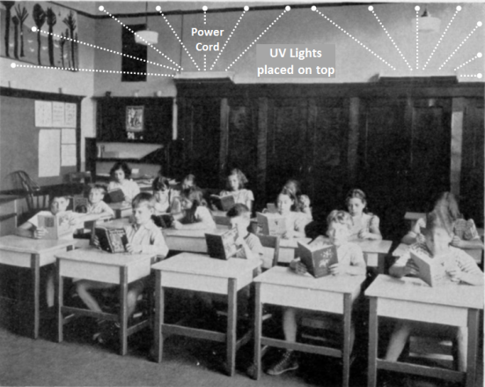
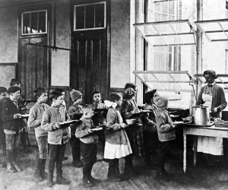
Our Parents and Grandparents
Swarthmore Public School Classroom
circa 1937 - 1943
Open windows Public School cafeteria
circa 1908
UPENN study with Ceiling Level UV lights.
First US fresh-air school for tubercular children opened in Providence in 1908 and by 1910 there were 65 fresh-air schools in the country.

Slide 5
Why is Ventilation Suddenly a Problem
COVID-19 is endemic, it is like tuberculosis, measles, and other airborne contagions from the previous century
It has been a leading cause of death for 2 years
To eventually eliminate tuberculosis and other airborne contagions, it took vaccines and modern forced air heat and cooling systems
Our building ventilation systems have been ignored during the time of great health when our parents and grandparents understood building ventilation

Slide 6
Professor Edward A. Nardell
Harvard Medical School
From Time Magazine February 1, 2022: If We're Going to Live With COVID-19, It's Time to Clean Our Indoor Air Properly, Edward A. Nardell is Professor of Global Health and Social Medicine, Harvard Medical School.
COVID-variants may be with us for years to come, and this will certainly not be the last respiratory virus pandemic. We have long suffered from annual contagious respiratory infections, but exceptionally low rates of influenza and common colds during COVID-precautions have demonstrated that not all of this suffering need happen. So, we need to think clearly and scientifically about how better we can reduce the spread of viruses indoors especially when and where masks will no longer be in common use.
Are there effective engineering controls that can help make indoor environments truly safer?

Slide 7
A Paradigm Shift to Combat Indoor Respiratory Infection
In May of 2021, 39 scientists published "A Paradigm Shift to Combat Indoor Respiratory Infection"
There is great disparity in the way we think about and address different sources of environmental infection. Governments have for decades promulgated a large amount of legislation and invested heavily in food safety, sanitation, and drinking water for public health purposes. By contrast, airborne pathogens and respiratory infections, whether seasonal influenza or COVID-19, are addressed weakly, if at all, in terms of regulations, standards, and building design and operation, pertaining to the air we breathe.

Slide 8
Ventilation
Ventilation what is it?
We hear that we need ventilation in small indoor spaces, But why?
We hear we need to increase ventilation but what does that mean?

Slide 9
Ventilation what is it?
It is about Ventilation performance levels
Ventilation performance is measured as Air Changes Per Hour (ACH)
ACH is a measure of how often air changes in a room
  1 ACH changes the room air 1 time per hour
  20 ACH changes the room air 20 times per hour
  or every 3 minutes (60 min / 3 min = 20 ACH)
ACH = Fan Cubic-feet per Hour / Room Cubic-feet

Slide 10
Ventilation what is it?
It is not about measuring and maintaining CO2 levels
Maintaining CO2 levels leads to a system with ACH levels that are too low such as 1 ACH or less
It is not about liters/min or cubic-feet/min per person, this will never provide visibility into the actual ACH level in a room and when scenarios are run the ACH levels are too low such as 1 ACH or less
Ventilation performance when dealing with airborne contagions is always in terms of ACH in a real room setting, not a lab or test fixture
Example: 60 min / air changed every 3 min = 20 ACH

Slide 11
Scenarios Analyzed
Key Research Findings
Small indoor space - problem is massive
Large indoor space - problematic
Outside - extremely rare
Mask on / off
Exposure time of 1, 4 , 8 hours
Various ventilation rates - key to reduce risk
Used Wells-Riley equation to develop scenarios
Scenarios show probability of infection
99% to .0003%

Slide 12
What should be the ACH Level?
0 leads to infection
1 leads to infection we know from data
CDC recommends 12 ACH for a hospital room with airborne contagion
The number must be greater than 1
As ACH increases the risk of infection drops

Slide 13
Mental Models to Understand ACH
Many address ACH levels as a percent of remaining contagions after 1 ACH
  One air change removes approximately 63% of room air contaminants, and a second air change removes about 63% of what remains, and so on
Systems engineering safety and reliability analysis is about probabilities, relative probabilities and time before failure
Applying systems engineering safety and reliability concepts to ACH provides a quick view on the effectiveness of ACH levels and how one can behave

Slide 14
ACH Various Analysis Perspectives
ACH | Remaining Virus * 63% / AC | Time (mins.) removal: 99% efficiency * | Time (mins.) removal: 99.9% efficiency * | Infection Risk (1/ACH) Safety world | Time to Infection (hours) Reliability world
0 | 100% | - | - | 100% | 1 or .5 or .25
1 | 63% | - | - | 100% or 50% | 1 or 4 or 6
2 | 40% | 138 | 207 | 50% | 2
4 | 16% | 69 | 104 | 25% | 4
6 | 6% | 46 | 69 | 17% | 6
8 | 2% | 35 | 52 | 13% | 8
10 | 1% | 28 | 41 | 10% | 10
12 | 0.39% | 23 | 35 | 8% | 12
15 | 0.10% | 18 | 28 | 7% | 15
20 | 0.01% | 14 | 21 | 5% | 20
50 | - | 6 | 8 | 2% | 50
* CDC Appendix B. Air Guidelines for Environmental Infection Control in Health-Care Facilities (2003), Medical world

Slide 15
Where do ACH standards and guidelines come from?
ASHRAE American Society of Heating, Refrigerating and Air-Conditioning Engineers
CDC Centers for Disease Control and Prevention
DOD Department of Defense Standards
ISO International Organization for Standardization
Others
Most of the ACH levels are based on comfort except for when airborne contagion mitigation is required in hospitals

Slide 16
ACH Standards & Guidelines
Area | ACH min | ACH max | Source | Area | ACH min | ACH max | Source
Hospital Trauma room | 15 | - | CDC | Classroom (Art) | 16 | 20 | EPA
Hospital room airborne precautions | 12 | - | CDC | Malls | 6 | 10 | EPA
Hospital operating room | 25 | - |  | Office | 8 | 30 | Greenheck
Hospital rooms | 6 | 10 | EPA | Engine Room | 20 | 60 | Greenheck
Restaurants | 8 | 12 | EPA | Kitchen | 12 | 60 | Greenheck
Restaurants | 8 | 20 | NCI | Kitchen | 7 | 8 | NCI

Slide 17
ACH Standards & Guidelines
Area | ACH min | ACH max | Source | Area | ACH min | ACH max | Source
Restaurants | 15 | 20 | wiki | Kitchen | 14 | 18 | NCI
Bar | 15 | 30 | Greenheck | Kitchens | 15 | 30 | EPA
Bar | 15 | 20 | NCI | Retail | 6 | 10 | NCI, wiki, EPA
Bar | 15 | 20 | wiki | Laboratory | 12 | 30 | Greenheck
School Classroom | 4 | 12 | EPA | Laboratory | 6 | 12 | wiki
Auditorium | 8 | 15 | EPA | Club Houses | 20 | 30 | EPA
Assembly Hall | 6 | 8 | EPA | Theatres | 8 | 15 | EPA
Swimming Pool | 20 | 30 | EPA

Slide 18
What have facility managers done?
Hawaiian airlines ventilation performance level is 20 ACH and they posted it for all passengers to see on their entertainment screens
Philadelphia restaurant program is 15 ACH and 106 restaurants participated
There is a public database with hundreds of facilities showing what they have done
https://www.cassbeth.com/cleanairbuildings/index.html

Slide 19
Facility Types
Research Findings
Facility Type | ACH Levels | Maintenance | Operations
Elite Facilities | Excellent | Excellent | Excellent
Medium Facilities | Lower | Excellent | Excellent
Low End Facilities | Lower | Poor | Excellent
Low End Facilities | Lower | Excellent | Poor
Low End Facilities | None | Poor | Poor
Where does your facility fall?

Slide 20
Ventilation Approaches
Research Findings
Approach | ACH / e ACH Levels | Comments
Natural Ventilation | 35+ | Open windows & Doors
HVAC | 4 to 6 typical | 12+ ACH are elite settings
Exhaust Fans | 60+ | Old bars, auto & machine shops…
Ceiling Level UV Lights | 24+ eACH | Well established 80+ years
Far UV 222 Lights | 24+ eACH | No need for surface cleaning
Room sanitizers | 1-2 | too small for public rooms, may be okay for small 1 person office
Will revisit the technologies at the end

Slide 21
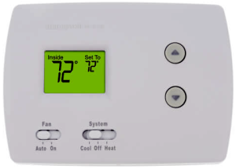
Home Ventilation Actions & Costs
Turn on the HVAC fan when guests arrive and turn it off when they leave
What about costs?
Typical home fan motor takes the equivalent power of 1 to 3, 100-watt lightbulbs

Slide 22
Public Buildings Ventilation
Actions & Costs
Must turn on ventilation system 1 hour before and after the public arrives and leaves – per CDC guidance
Most commercial facilities are not on demand systems and the fans run all the time, no cost impacts
  However, there are serious maintenance issues
  That is why the ACH levels must be determined and posted
Facilities using on demand systems, some cost impacts
  They are negligible because the fans take little power once compared to heating and cooling
  Instead of using the HVAC or exhaust fans they can install ceiling level UV or far UV 222 systems, which will run at about 10% of the mechanical motors

Slide 23
Commercial Building Challenges
It is more about proper maintenance and operation because this will lead to ACH = 0 or ACH = 1
Are vents blocked
Are dampers partially closed by someone
Are timers working properly
Are sensors, fans, and dampers working properly
Do vents have streamers so people can see system is working
Periodic inspections with documented evidence using certificates that are posted will ensure effective maintenance

Slide 24
What Can Be Done
Operations
Turn on the HVAC FANs 1 hour before people enter and 1 hour after people leave the facility
When entering a facility, make sure the fans are turned on, if not turn them on
Place a sign at each thermostat stating to turn on the fan and show how to turn on the fan
If the fans fail to operate or you are unable to see the thermostat display report it immediately
Setup training sessions to show people how to turn on fans

Slide 25
What Can Be Done
Maintenance
Make sure all the HVAC FANS work
Make sure the vents are not blocked or closed
Place streamers on all the vents so people can see they work
Replace the batteries in all the thermostats so that the displays are visible, and people can see what they are doing
Ensure that the filters are replaced every 3 months

Slide 26
What Can Be Done
Disclosure
Measure Room Performance
Using anemometers, measure the air flow from each vent and calculate the measured ACH levels
Gather design data to determine design ACH levels
Disclosure
Disclose ACH levels for each room via emails and websites
Post room certificates showing the measured ACH levels
Update the certificates every 3 months to show the system is being monitored and maintained

Slide 27
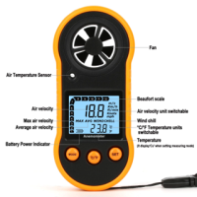
Tools to Measure ACH Levels
Tape measure to determine room size
Anemometer
https://www.amazon.com/Anemometer-Handheld-Detector-Temperature-Windsurfing/dp/B07ZJ38ZMX
ACH = Vents cu-ft per hour / room cubic feet

Slide 28
Measured ACH Level
House Pre COVID-19
Num | Room Name | Num of Vents | ACH | System On yes, no, fail
0. | Living Room | 2 | 2.3 | No
1. | Dining Room | 1 | 2.8 | No
2. | Family Room | 1 | 1.7 | No
3. | Kitchen | 1 | 3.8 | No
4. | Breakfast Room | 1 | 4.9 | No
5. | Sunroom | 1 | 3.3 | No
6. | Bedroom 1 Master | 2 | 3.6 | No
7. | Office | 1 | 2.9 | No
8. | Bathroom 1 | 1 | 3.4 | No
9. | Powder Room | 1 | 6.2 | No
Note: Open spaces share ACH with adjacent spaces. All values are approximate because of ceiling height and vent size approximations.

Slide 29
Measured ACH Level
House
Num | Room Name | Num of Vents | ACH | System On yes, no, fail
0. | Living Room | 2 | 2.3 | Yes
1. | Dining Room | 1 | 2.8 | Yes
2. | Family Room | 1 | 1.7 | Yes
3. | Kitchen | 1 | 3.8 | Yes
4. | Breakfast Room | 1 | 4.9 | Yes
5. | Sunroom | 1 | 3.3 | Yes
6. | Bedroom 1 Master | 2 | 3.6 | Yes
7. | Office | 1 | 2.9 | Yes
8. | Bathroom 1 | 1 | 3.4 | Yes
9. | Powder Room | 1 | 6.2 | Yes
Note: Open spaces share ACH with adjacent spaces. All values are approximate because of ceiling height and vent size approximations.

Slide 30
Measured ACH Level
House – in the past
Num | Room Name | Num of Vents | ACH | System On yes, no, fail
10. | Foyer (open space) | 0 | 0 | Yes
11. | Loft | 2 | 4.1 | Fail
12. | Bedroom 2 | 2 | 6 | Fail
13. | Bathroom 2 | 1 | 3.8 | Fail
14. | Laundry Room | 1 | 8.2 | Yes
15. | Stairs (open space) | 0 | 0 | Yes
16. | Hall 1 (open space) | 0 | 0 | Yes
17. | Hall 2 (open space) | 0 | 0 | Yes
Note: Open spaces share ACH with adjacent spaces. All values are approximate because of ceiling height and vent size approximations.

Slide 31
Measured ACH Level
House
Num | Room Name | Num of Vents | ACH | System On yes, no, fail
10. | Foyer (open space) | 0 | 0 | Yes
11. | Loft | 2 | 4.1 | Yes
12. | Bedroom 2 | 2 | 6 | Yes
13. | Bathroom 2 | 1 | 3.8 | Yes
14. | Laundry Room | 1 | 8.2 | Yes
15. | Stairs (open space) | 0 | 0 | Yes
16. | Hall 1 (open space) | 0 | 0 | Yes
17. | Hall 2 (open space) | 0 | 0 | Yes
Note: Open spaces share ACH with adjacent spaces. All values are approximate because of ceiling height and vent size approximations.

Slide 32
Measured ACH Level
House
Room Name | Num of Vents | ACH
Aggregate | 18 | 3.2
Max | - | 8.2
Min (includes 0) | - | 0
Lowest (excludes 0) | - | 1.7
Average ACH (affected by room sizes) | - | 3.3
HVAC Design ACH = 4
Difference between measured and design is reductions caused by air resistance from filter and ducts
Note: Open spaces share ACH with adjacent spaces. All values are approximate because of ceiling height and vent size approximations.

Slide 33
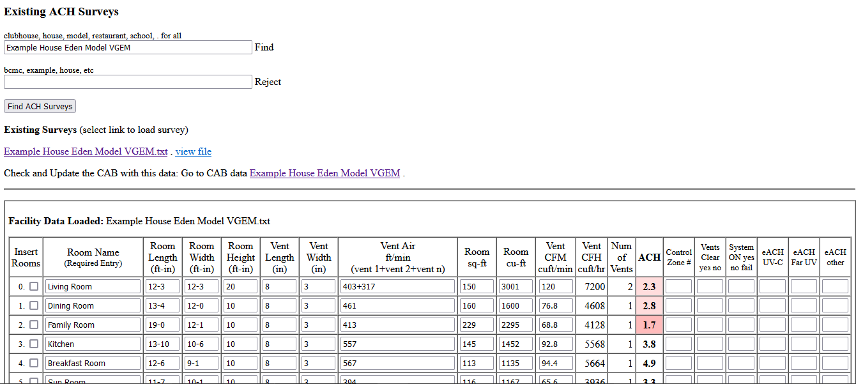
How was this done
Anemometer
Dollar store broom sticks (2)
Selfie stick to hold Anemometer
ACH = Vents cu-ft per hour / room cubic feet

Slide 34
Clean Air Buildings Database
https://www.cassbeth.com/cleanairbuildings/index.html
Search examples
  Philadelphia Schools (ACH site survey data)
  Philadelphia Restaurant Program (ACH site survey data)
  School
  Restaurant
  Airport
  Airplane

Slide 35
Any Facility
Suggested Short Term Action Plan
Fix any broken fans so that they operate
Fix areas that have zero ventilation readings
  Open any closed dampers and vents because of previous complaints of hot or cold air
  Adjust or change vent types so that there are no complaints but keep the vents open
Post signs to turn on the fans and provide simple instructions
Post certificates at each thermostat with a date showing last maintenance date and average ACH level
Place streamers on all vents
Do this until the COVID-19 disaster is over in about 10 years

Slide 36
HVAC Inspection Certificate
Zone (1, 2, 3, 4, 5, 6, pool): example A
HVAC Vendor Name & Visit date: HVAC 05/21/22
Filter Change Date & MERV Rating: 5/21/22 MERV 13
Fan Mode Operational (yes/no): Yes
All Vents Operational (yes/no): Yes
Thermostat Display Visible: (yes/no): Yes
Timers Working & Set: (yes/no): Yes
Thermostat Instructions: (yes/no): Yes
Staff Turn On Fans On Entry (yes/no): Yes
Fan CFM: 1,600

Slide 37
Room Certificate Key Elements
Room Name & Zone: 136B Classroom
Square feet: 1142
Cubic feet: 9136
CFM: 483
ACH Level: 3.1
Vents Unblocked: yes/no Yes
Dampers Open: yes/no Yes
Timers Working: yes/no no data
Inspection Authority and Date: Phila School District, 2021
Comments: Posted Online by Phila

Slide 38
Building Certificate Key Elements
Building Name & Address: Thomas Edison High School
Square feet: 179,612
Cubic feet: 1436896
CFM: 89361
Min ACH Level: 0.7
Max ACH Level: 73.2
Average ACH Level: 5.1
Inspection Authority and Date: Phila School District, 2021
Comments: Posted Online by Phila

Slide 39
Any Facility
Suggested Long Term Action Plan
Consider adding ceiling level / upper room UV-C lights
  Proven technology, massive science & engineering going back to 1937
  Used in commercial & industrial settings and public buildings like hospitals, elite schools, elite restaurants, elite condominiums, etc.
  This will add an additional 24 eACH to the rooms
Consider adding FAR UV-222 lights
  Relatively new based on LED technology
  Science & engineering based on ceiling level UV-C lights
  This will add an additional 24 eACH to all other rooms
  Will eliminate surface cleaning need
  See next slide for references and presentations

Slide 40
Any Facility
Suggested Long Term Action Plan
Ceiling level / upper room UV-C and FAR UV-222
The Second Gilbert W. Beebe Webinar: Safety and Efficacy of UVC to Fight Covid-19, National Academies of Sciences, Engineering, and Medicine, Sep 16, 2020.
https://www.nationalacademies.org/event/09-16-2020/the-second-gilbert-w-beebe-webinar-safety-and-efficacy-of-uvc-to-fight-covid-19
The National Academy of Sciences (NAS) is a private, non-profit society of distinguished scholars. Established by an Act of Congress, signed by President Abraham Lincoln in 1863, the NAS is charged with providing independent, objective advice to the nation on matters related to science and technology.

Slide 41
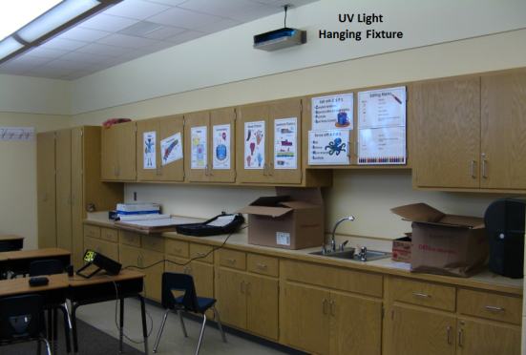
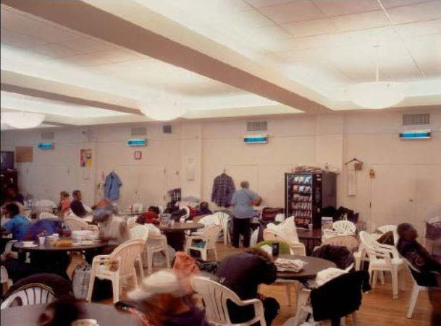
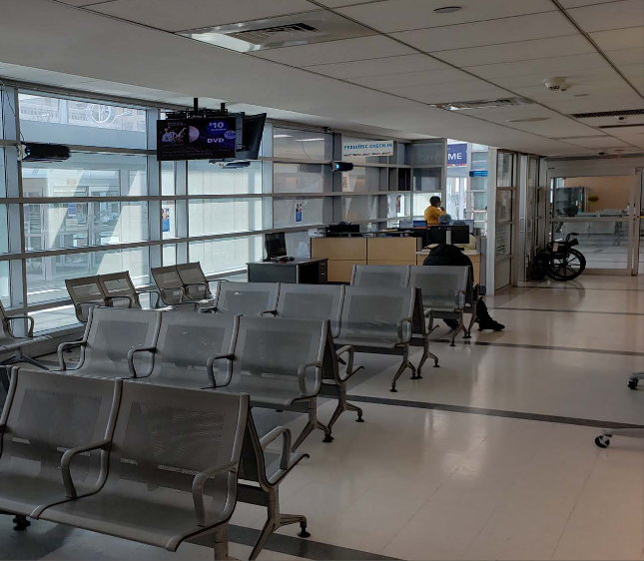
Ceiling Level UV-C Examples

Slide 42
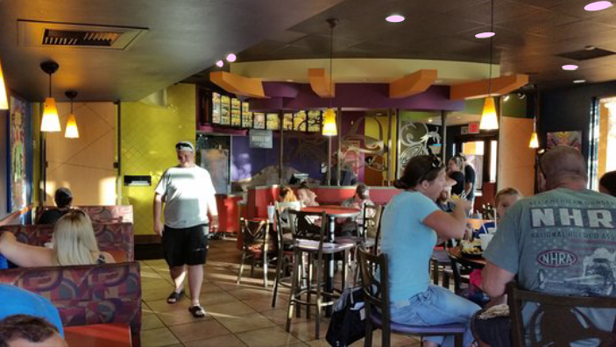
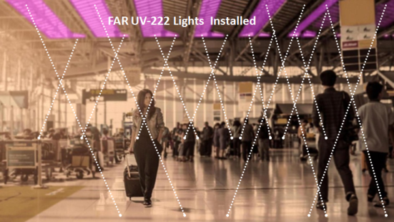
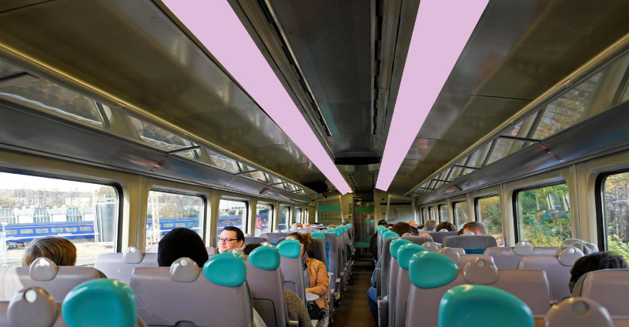
FAR UV-222 Examples
Surface Cleaning NOT Required!

Slide 43
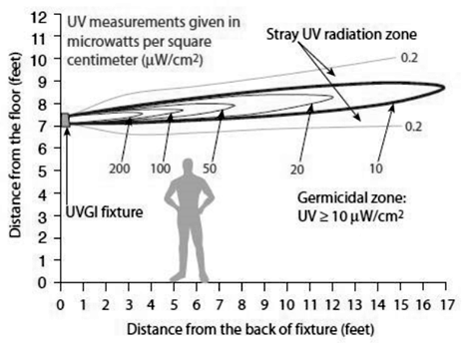
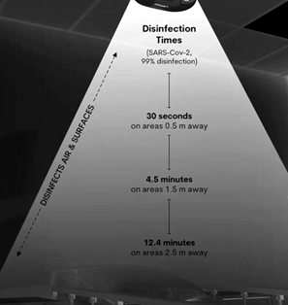
Ceiling Level UV-C and FAR UV-222 Characteristics eACH = 24
Ceiling Level UV-C
FAR UV-222

Slide 44
Closing Comments
In the last century, our parents and grandparents had to deal with tuberculosis and other deadly infections
Vaccines did a great deal to eliminate those contagions, but they would not have worked without the introduction of forced air HVAC systems and ceiling level UV systems
Unlike in the last century no new technology is needed, we just need to use what our parents and grandparents developed
There always will be unvaccinated people
The system solution must use vaccines + ventilation
The analysis clearly shows why; large numbers of people will continue to get sick and die – see this research findings

Slide 45
ACH Impact on Lives Saved
2020 Analysis: impact of each of the mitigation subsystem on lives saved
System = Vaccine Subsystem + HVAC Subsystem + UV Subsystem
Naturally Immune % | Vaccine Effectiveness % | Vaccinated % | Deaths @ 3.5% * | UV-C or FAR UV-222 | Deaths @ 3.5% (With UV) | Ventilation Effectiveness 4 AUC | Deaths @ 3.5% (With UV + Ventilation)
10% | 70% | 70% | 5,269,320 | 90% | 526,932 | 28% | 379,391
10% | 90% | 90% | 1,963,080 | 90% | 196,308 | 28% | 141,342
0% | 70% | 70% | 5,854,800 | 90% | 585,480 | 28% | 421,546
0% | 90% | 90% | 2,181,200 | 90% | 218,120 | 28% | 157,046
.
0% | 0% | 0% | 11,480,000 | 90% | 1,148,000 | 28% | 826,560
10% | 0% | 0% | 10,332,000 | 90% | 1,033,200 | 28% | 743,904
* For less than 3.5% just divide all the numbers by 3 and they are still massive

Slide 46
Closing Comments
It will take years for the building codes to change to include contagion mitigation, so what can we do?
Stop using the phrase - increase ventilation
We must talk in terms of ventilation performance levels using the decades old ACH levels
We must post ACH levels throughout our buildings

Slide 47
Closing Comments
We are not here to determine future minimum ACH levels that will become part of future building certificates of occupancy
We are here to begin to measure and document the building ventilation levels and post the resulting ACH performance levels in all buildings everywhere
This approach of building assessment and disclosure was inspired by a 2021 Drexel Faculty Meeting

Slide 48
Facility Types
Facility Type | ACH Levels | Maintenance | Operations
Elite Facilities | Excellent | Excellent | Excellent
Medium Facilities | Lower | Excellent | Excellent
Low End Facilities | Lower | Poor | Excellent
Low End Facilities | Lower | Excellent | Poor
Low End Facilities | None | Poor | Poor
Where do you want to live and work?

Slide 49
How to Proceed
Grass Roots Level Approach
Fill out and submit the form
Building Ventilation Performance Levels Disclosure Request
https://www.cassbeth.com/cleanairbuildings/info-sheet.html
Click on PDF or .docx links
Print pages 1 - 5 and drop off at clubhouses, work, school, house of worship, restaurants, bars, store customer service desks, etc.

Slide 50
References
CDC ACH Guidelines
[1] CDC Appendix B. Air Guidelines for Environmental Infection Control in Health-Care Facilities (2003) https://www.cdc.gov/infectioncontrol/guidelines/environmental/appendix/air.html
[1.2] CDC Guidelines for Environmental Infection Control in Health-Care Facilities, July 2019. https://www.cdc.gov/infectioncontrol/pdf/guidelines/environmental-guidelines-P.pdf

Slide 51
References
Philadelphia Restaurant Program
[2.1] Enhanced Ventilation Standards for Indoor Dining and Application Form for Increased Dining Capacity, City of Philadelphia, February 14, 2021. webpage https://www.phila.gov/media/20210216105327/Enhanced-Ventilation-Standards-for-Indoor-Dining_2_16_21.pdf
[2.2] Food Establishments That Have Met Enhanced Ventilation Standards to Allow for Increased Indoor Dining Capacity, City of Philadelphia, March 09, 2021. webpage https://www.phila.gov/media/20210311122403/50CapacityRestaurants_030921.pdf
[2.3] EHS Enhanced Ventilation Standards for Indoor Dining, February 16, 2021. webpage https://www.youtube.com/watch?v=HlneLDi9r54
[2.4] EHS TIPS Enhanced Ventilation Standards for Indoor Dining, February 16, 2021. webpage https://www.youtube.com/watch?v=58uRfAxh6Cw

Slide 52
References
School Case History
[3.1] 8 Classmates, 2 Fully Vaccinated Family Members, Test Positive for COVID in Lower Merion, NBC 10 Philadelphia, April 25, 2021. webpage https://www.nbcphiladelphia.com/news/coronavirus/8-classmates-2-fully-vaccinated-family-members-test-positive-for-covid-in-lower-merion/2791754
[3.2] Lower Merion School District says a ventilation flaw could have fueled a COVID-19 outbreak in second-grade classroom, The Philadelphia Inquirer, April 26, 2021. webpage https://www.inquirer.com/education/lower-merion-school-district-penn-valley-covid-outbreak-hvac-20210426.html
[3.3] Drexel Faculty Meeting. The Lower Merion School District staff evaluated the classroom HVAC system and found that a part within the ductwork above the ceiling was mostly closed allowing only about 30% of the maximum amount of fresh air into the room where the 2d grade children were infected. The design requirement for the school HVAC system is 375 CFM and the measured rate was 120 CFM for the affected classroom.

Slide 53
References
Building Codes and Standards
[4.1] International Building Code (IBC), webpage, https://codes.iccsafe.org/content/IBC2018P3/chapter-12-interior-environment#IBC2018P3_Ch12_Sec1202, https://codes.iccsafe.org/content/IBC2021P2/index
[4.2] International Mechanical Code (IMC), webpage https://codes.iccsafe.org/content/IMC2015/chapter-4-ventilation
[4.3] American Society of Heating, Refrigerating and Air-Conditioning Engineers (ASHRAE), webpage https://www.ashrae.org
Its all about comfort levels and reducing costs resulting in drastically reduced ventilation rates!
Sustainability requirements are further reducing ventilation rates!

Slide 54
References
Philadelphia Schools Site Surveys
[5] Philadelphia School District, Ventilation and Air Balance Reports, City of Philadelphia. March 22, 2021. webpage https://docs.google.com/spreadsheets/d/18Kn2h5zS6ivX27-msM2Pdy10HUUWaUAomAaXJJ2FK7w/edit#gid=999445241

Slide 55
References
Flu Season Costs
[6.1] Flu Season to Cost Business $17B in Lost Productivity, New Jersey Business & Industry Association NJBIA, January17,2019. webpage https://njbia.org/flu-season-to-cost-business-17b-in-lost-productivity
[6.2] Past Seasons Estimated Influenza Disease Burden, Centers for Disease Control and Prevention, October 01, 2020, webpage https://www.cdc.gov/flu/about/burden/past-seasons.html
[6.3] Inpatient Hospital Stays and Emergency Department Visits Involving Influenza, 2006-2016, Agency for Healthcare Research and Quality, October 2019. webpage https://www.hcup-us.ahrq.gov/reports/statbriefs/sb253-Influenza-Hospitalizations-ED-Visits-2006-2016.jsp

Slide 56
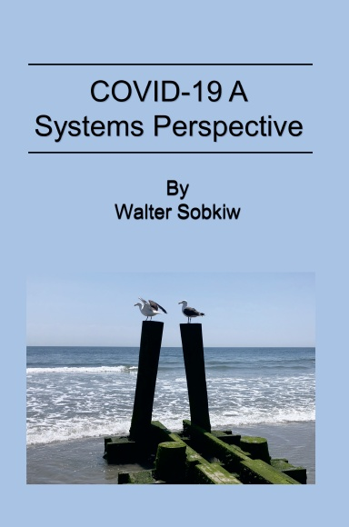
Links & Contact
This Presentation & All Research
https://www.cassbeth.com/cleanairbuildings/presentations/Ventilation-Education-handouts.pdf
https://www.cassbeth.com/covid-19/index.html (massive)
ACH Assessment Tools
https://www.cassbeth.com/cleanairbuildings/index.html
https://www.cassbeth.com/covid-19/faq.html
Contact
walt@cassbeth.com
walter.sobkiw@drexel.edu

Slide 57
Building Ventilation
What Everyone Should Know
Presented to a Homeowners Association Residents
Walt Sobkiw
June 2022
This is ongoing COVID-19 research from a systems perspective
Disclaimer: This event is not sponsored or approved by the Homeowners Association.

